Slide 1
Analysis of NYC Hotels Listed on Tripadvisor
Yasuhiro Shinohara
Notes:
9 min speech

Slide 2
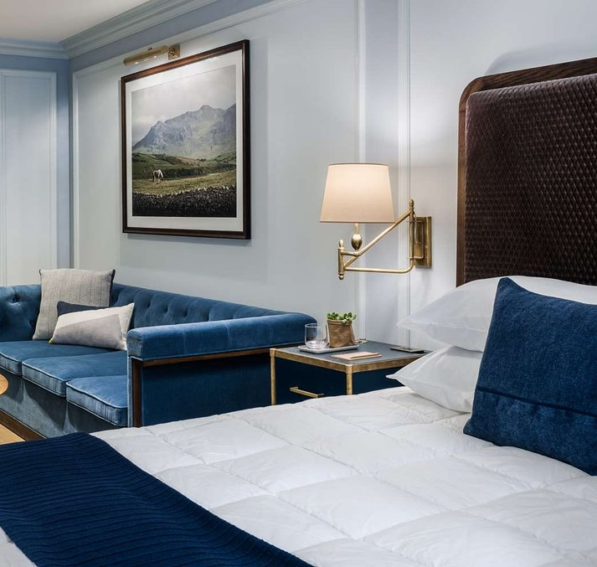
Agenda
Motivation
Methodology
Surface Analysis
Variables for Success
Location
Quality of Life
Conclusion
Next steps
Photo: Merrion Row Hotel and Public House
Source: Tripadvisor.com
Notes:
30 sec

Slide 3

Motivation
Exploration of opportunities for hotel businesses to grow.
Confirmation of successful business strategies.
Recognizing common consumer interests
Opportunity for personal growth by analyzing data using scrapy package of python
Notes:
1 minutes. Dangerous to ramble here

Slide 4
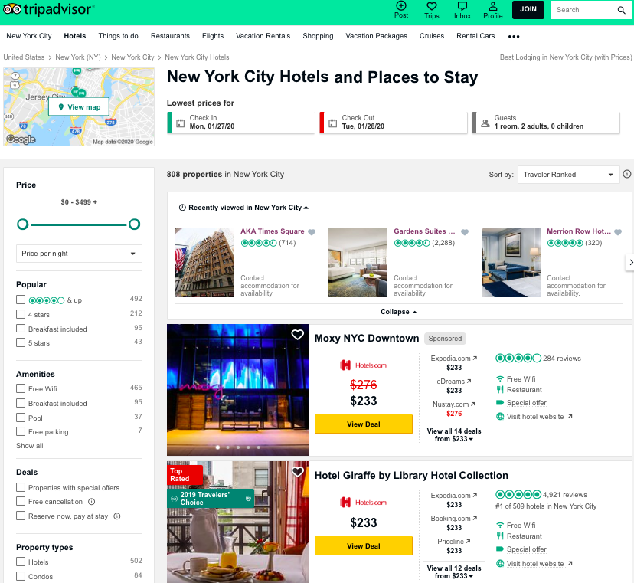
Methodology
Extracted the following information from Tripadvisor.com using scrapy:
Company Name
Overall Rating from Tripadvisor
Consumer Ratings
Number of Reviews
Address
Number of Restaurants within 0.3 mi
Number of Attractions within 0.3 mi
Tripadvisor Walking Grade (Activities within walking distance)
Hotel service (Property Amenities, Room features, Room service)
714 Hotel entries pulled
Notes:
1 min MAX

Slide 5
Surface Analysis

Slide 6
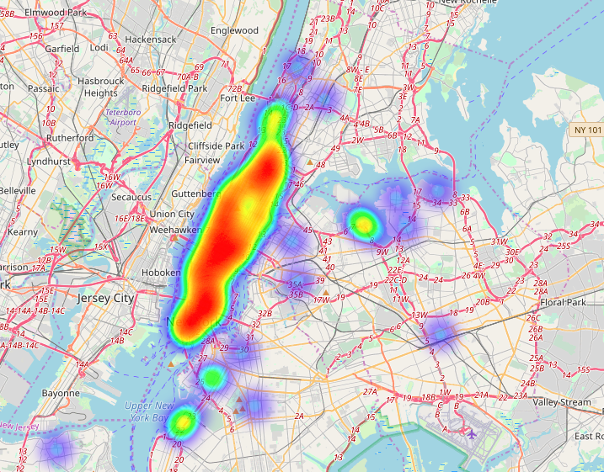
Hotel Location
Heat map of all hotel listings
Warm colors = Higher density
Cool colors = Lower density

Slide 7
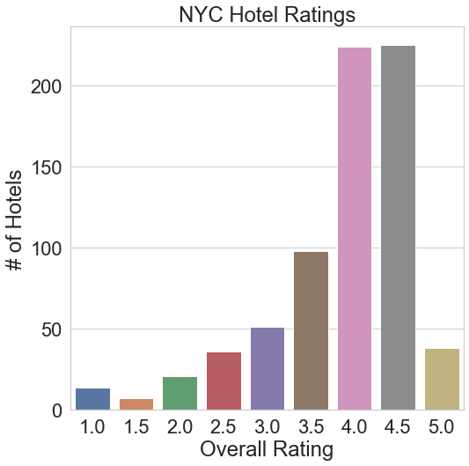
Hotel Ratings
Quantitative outlook of overall hotel ratings.
Highest rating = 5.0
Lowest rating = 1.0

Slide 8
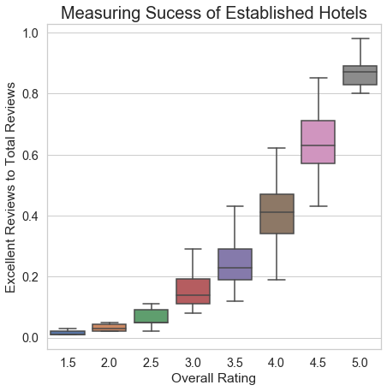
Measuring Success
Comparison of overall hotel ratings to the ratio of received excellent reviews to total reviews.
Technique only works with established companies (Reviews ≥ 50)
High ratings companies maintain high excellent review scores equates to consumer satisfaction.

Slide 9
Variables for Success

Slide 10
Classification Class
Define following terms to classify established companies (reviews ≥ 50 ):
Excellent: Overall ratings > 4.0
Good: Overall ratings 3.0 - 4.0
Poor: Overall ratings < 3.0

Slide 11
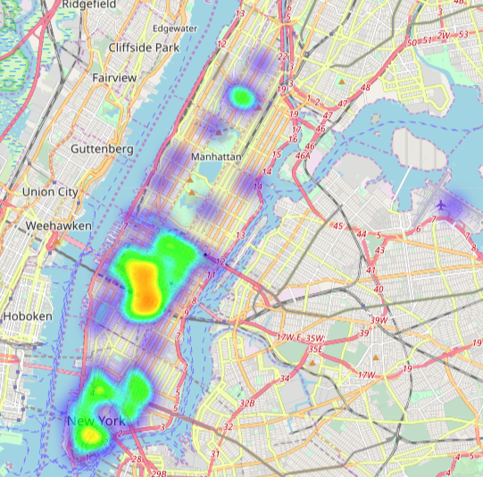
Excellent Hotels
157 locations of excellent hotels visualized using a heat map
Maps focused on Manhattan

Slide 12
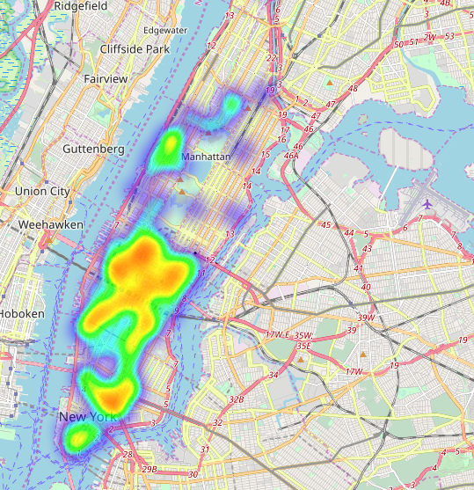
Good Hotels
284 locations of good hotels visualized using a heat map

Slide 13
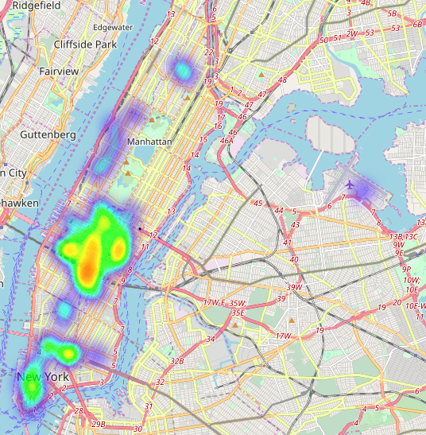
Poor Hotels
78 locations of poor hotels visualized using a heat map

Slide 14
Success Variable: Location
Maps display that location is not an indicator of success.
Takeaway: When starting a new hotel business in NYC, Manhattan is a preferred location, but should consider resources towards other variables for higher success.

Slide 15
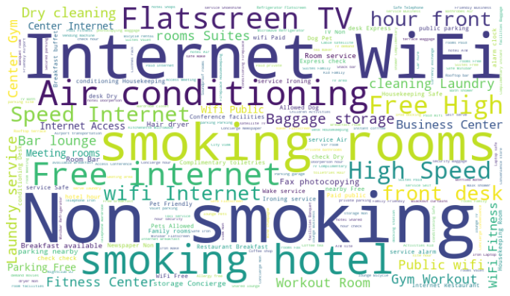
Common Hotel Services

Slide 16
Common Hotel Services
Every business is expected to offer the following services to meet customer needs.
Flatscreen TV
High speed Internet Wifi
Air conditioning
Non smoking/smoking

Slide 17
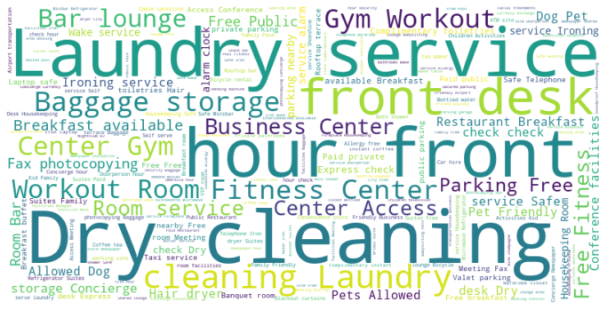
Offered Services from Excellent Hotels
214 unique services found, Avg 14.75 services/hotel

Slide 18
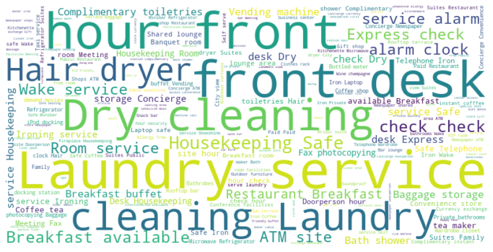
Offered Services from Good Hotels
168 unique services found, Avg 14.80 services/hotel

Slide 19
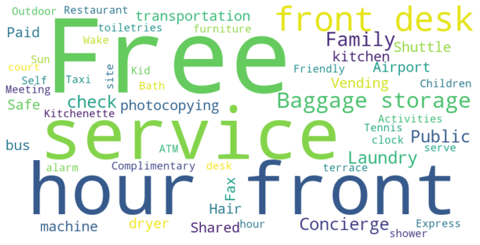
Offered Services from Poor Hotels
39 unique services found, Avg 14.75 services/hotel

Slide 20
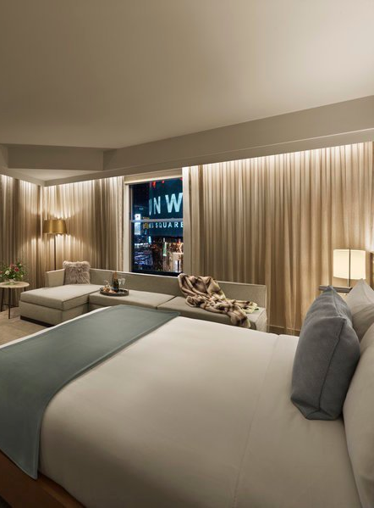
Success Variable: Services
Businesses should meet consumer expectations on hotel services.
The differences of average number of listed services between classified classes are marginal.
Successful businesses list unique services as incentive.
Unless promoting “Free internet”, avoid using the word “Free”.
Photo: The Knickerbocker Hotel
Source: Tripadvisor.com

Slide 21

Conclusion
NYC Hotels listed on Tripadvisor displays many listings are located in Manhattan, however, there is no relationship between business success and location.
For business growth, companies should list unique services and pursue excellent reviews
This information is valuable for consulting companies, hotel businesses, and completing travel platforming sites.
Photo: Park Terrace Hotel on Bryant Park
Source: Tripadvisor.com

Slide 22
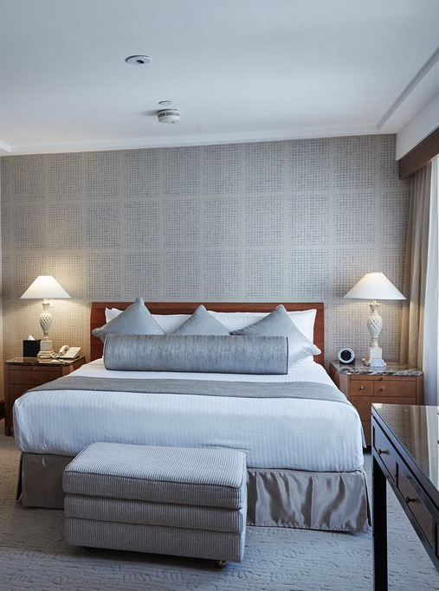
Next Steps for this Project:
Create an application that will allow you to find a hotel with the desired features.
Incorporate a method to efficiently extract price deals for analyzing price prediction.
Photo: The Kitano Hotel New York
Source: Tripadvisor.com

Slide 23
Thank you
To find more information about Yasuhiro Shinohara visit linkedin:
https://www.linkedin.com/in/yasuhiro-shinohara-475368b0/

